Slide 1



Music Recommendation system
Guided by:
Submitted By:
Mr. Amey Manjrekar
Mr. Sanjay Sane
RUTUJA ARSULE(210543083003)
GAURAV LANGAR(210543083008)
PRIYA MALI (210543083011)
POOJA CHASKAR(210543083021)

Slide 2
Outline
      Introduction
      Problem Statement
      System Architecture
      Data Pre-Processing
      Methodology
      Machine Learning Algorithms
      Data Visualization & Representation
      Conclusion
      Future Scope
      References

Slide 3
Introduction
  In simple words, a recommendation system is any system that automatically suggests content for website readers and users. These systems were evolved as intelligent algorithms, which can generate results in the form of recommendations to users.
  A variety of techniques have been proposed till today for performing recommendations.
  Recommendation system is defined as the computer program that helps the user to determine goods and content by predict the users rating of each item and presentation them the substance that they would rate highly. There are different ways to approach a recommendation system. They are basically divided into Content-based and Collaborative Filtering systems. In our project we are using Collaborative filtering.

Slide 4
Problem Statement
  To build a Music Recommendation System which recommends the songs.

Slide 5
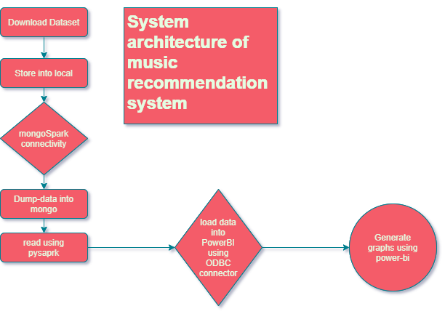
System Architecture

Slide 6
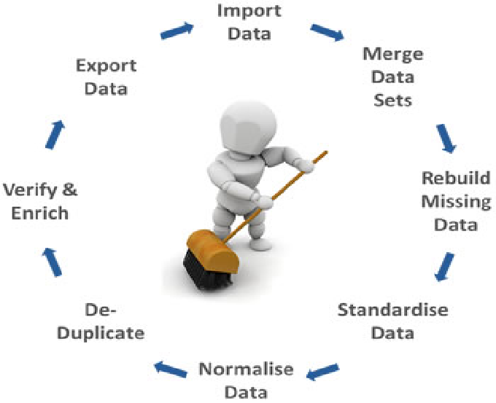
Data Pre-Processing

Slide 7
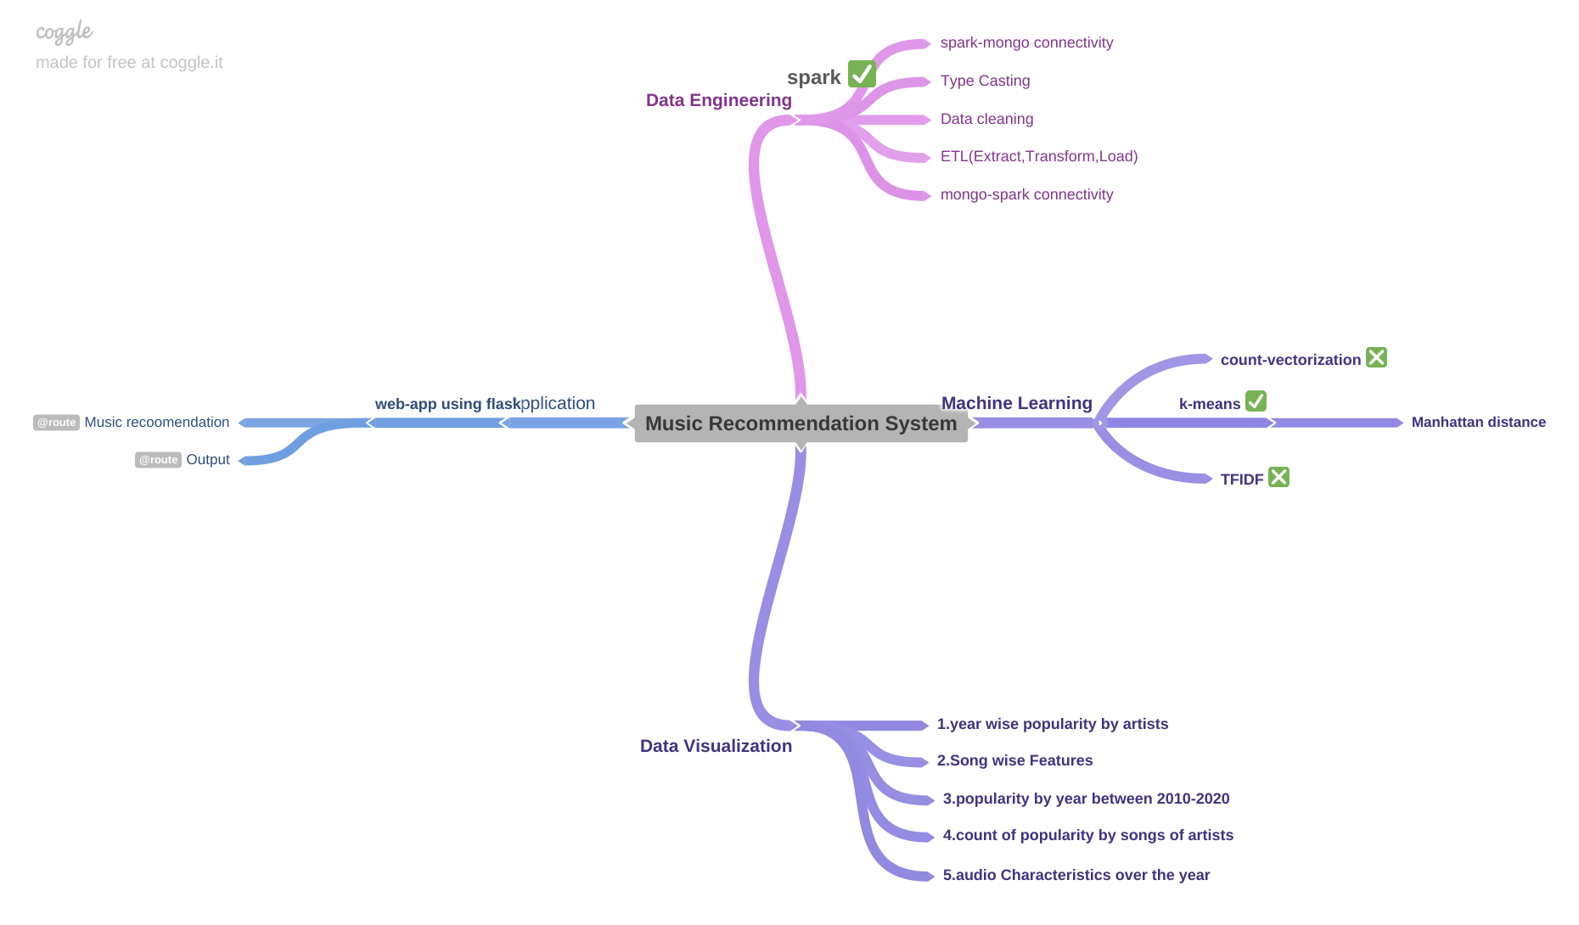
Methodology

Slide 8
Machine Learning Algorithms
1.K-means:
  K Means is a clustering algorithm which divides observations into k clusters. Since we can dictate the amount of clusters, it can be easily used in classification where we divide data into clusters which can be equal to or more than the number of classes.
2.Song Recommendation System:
  Song Recommendation System Building a recommendation system where it recommends similar songs for any given Song. Here I have used Neighborhood Collaborative Filtering using the similarity metrics method. Calculated Manhattan Distance using all numerical features available in the dataset and find the neighbor songs which have relatively less distance.

Slide 9
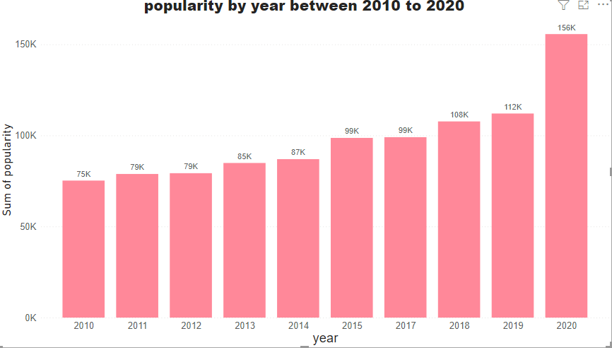
Data Visualization & Representation

Slide 10
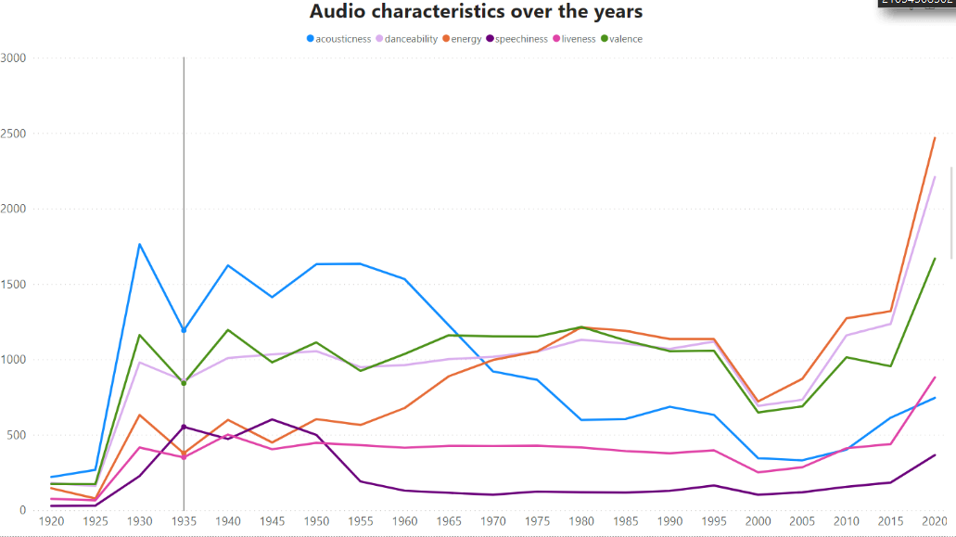

Slide 11
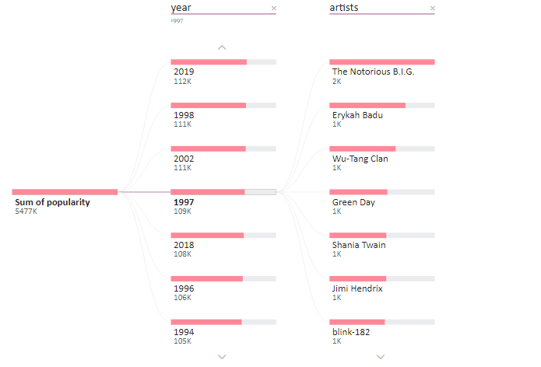
Year wise popularity By Artist

Slide 12
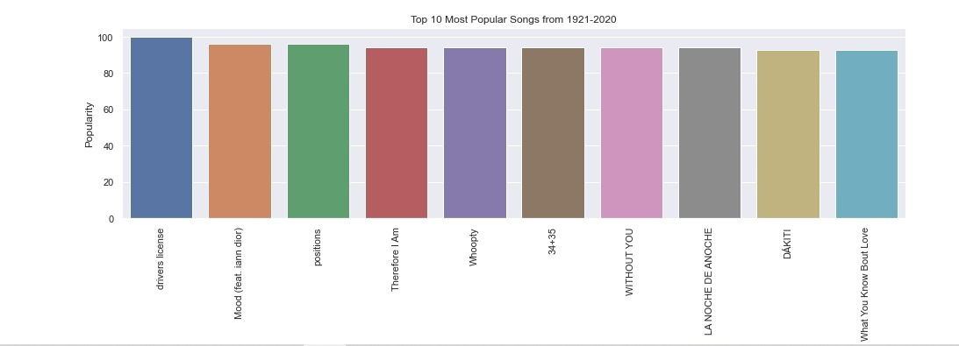

Slide 13
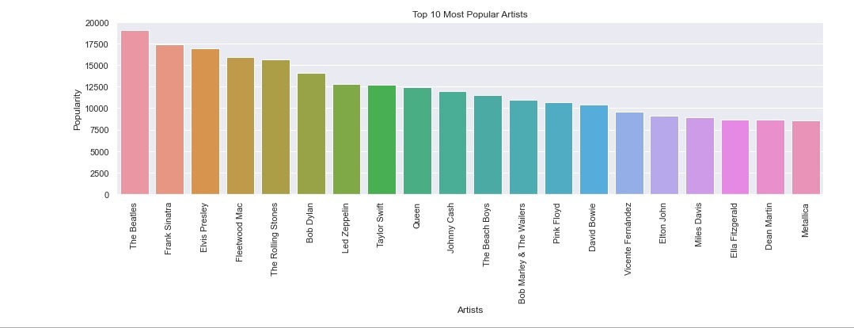

Slide 14
CONCLUSION
  To conclude about our project, we have made analysis of different research papers and algorithm implemented in it about recommendation systems. In our project we have improvised and modiﬁed the recommendation systems. This music Recommendation System has considered many parameters like Popularity, songs name, artists name, released year etc. We successfully implemented and found the similar books using Manhattan distance. Also, the recommendation system was implemented using Spotify dataset and popular dataset and k-means algorithm to display most similar Songs.

Slide 15
FUTURE SCOPE
  In future researchers can also build movie recommendation system along with music recommendation on a single platform like Amazon Prime.

Slide 16
Thank you…!

